Slide 1
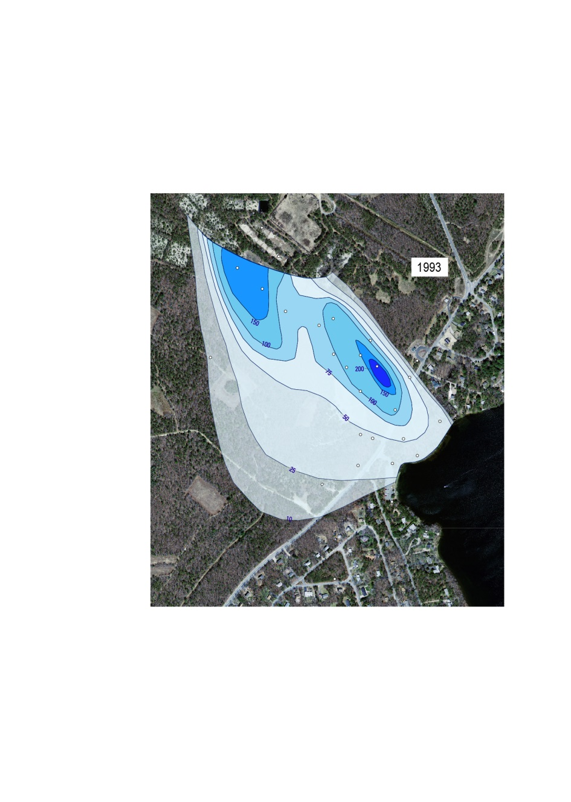
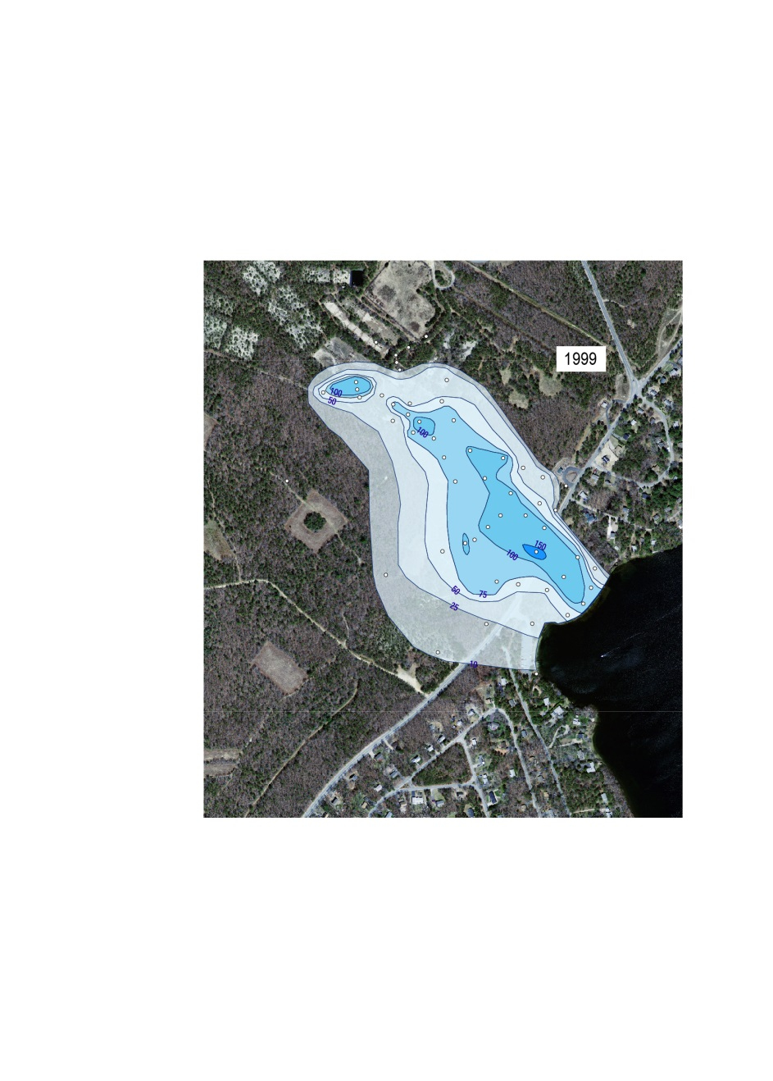
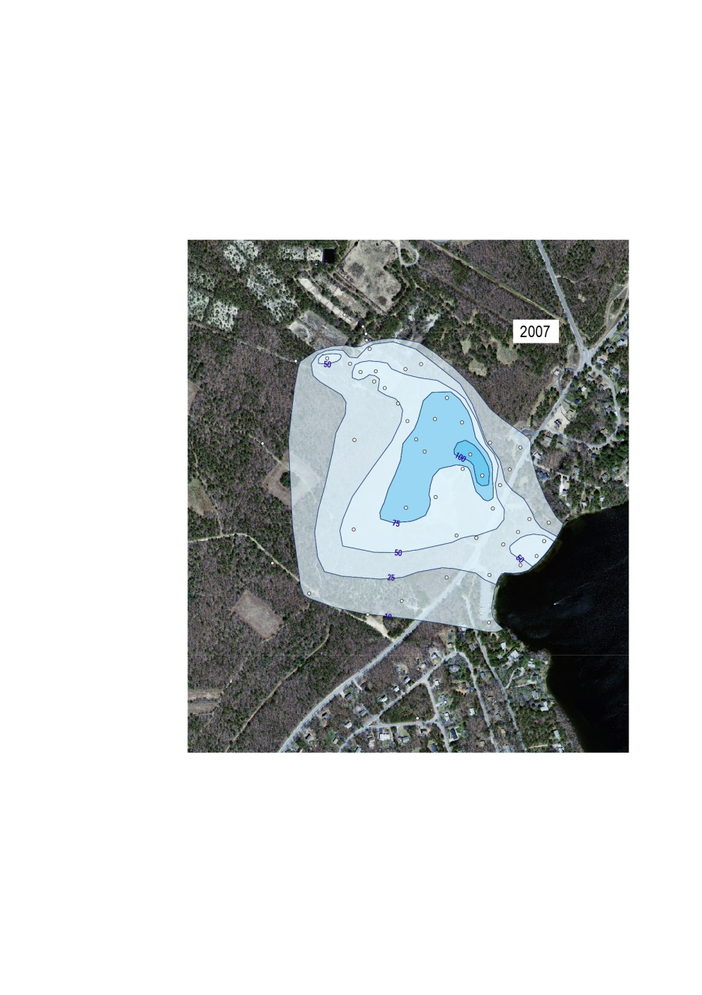
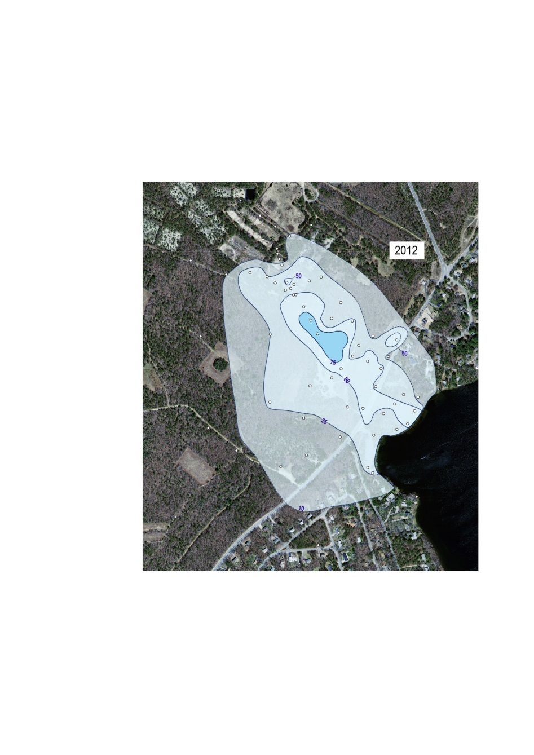
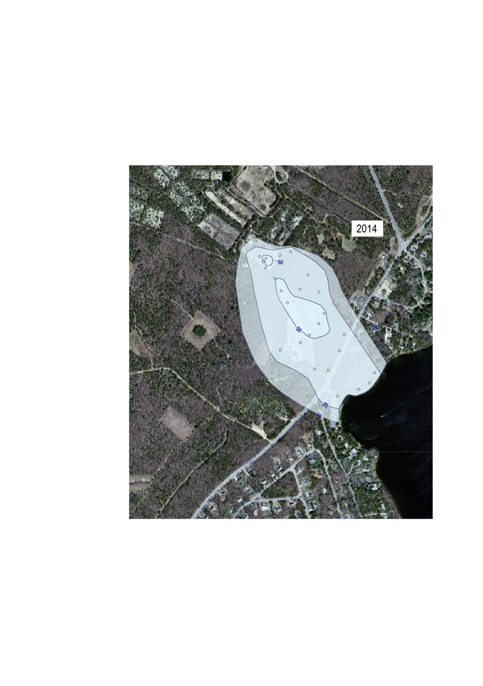
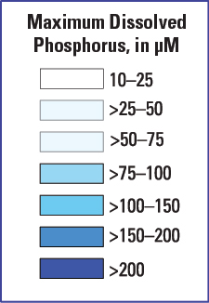
Comprehensive snapshots
of phosphate plume

Slide 2

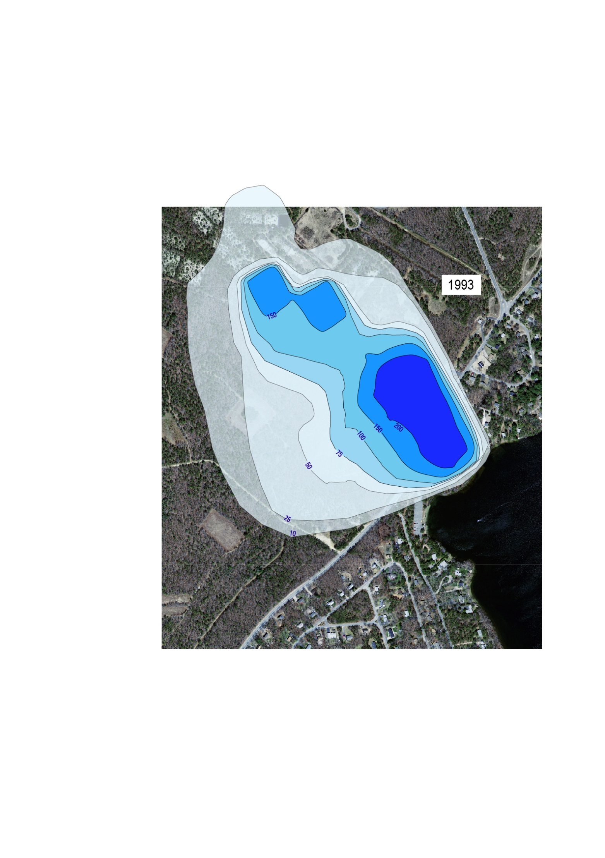
Laboratory Results
Model Prediction
1993
1993 (Calibration snapshot)

Slide 3

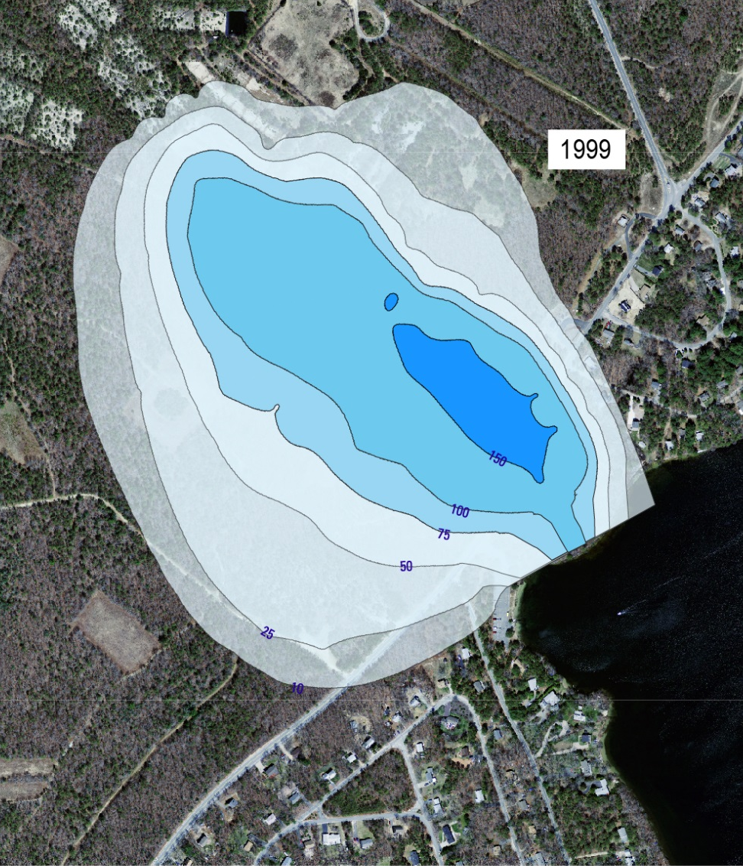
Laboratory Results
Model Prediction
1999
1999

Slide 4
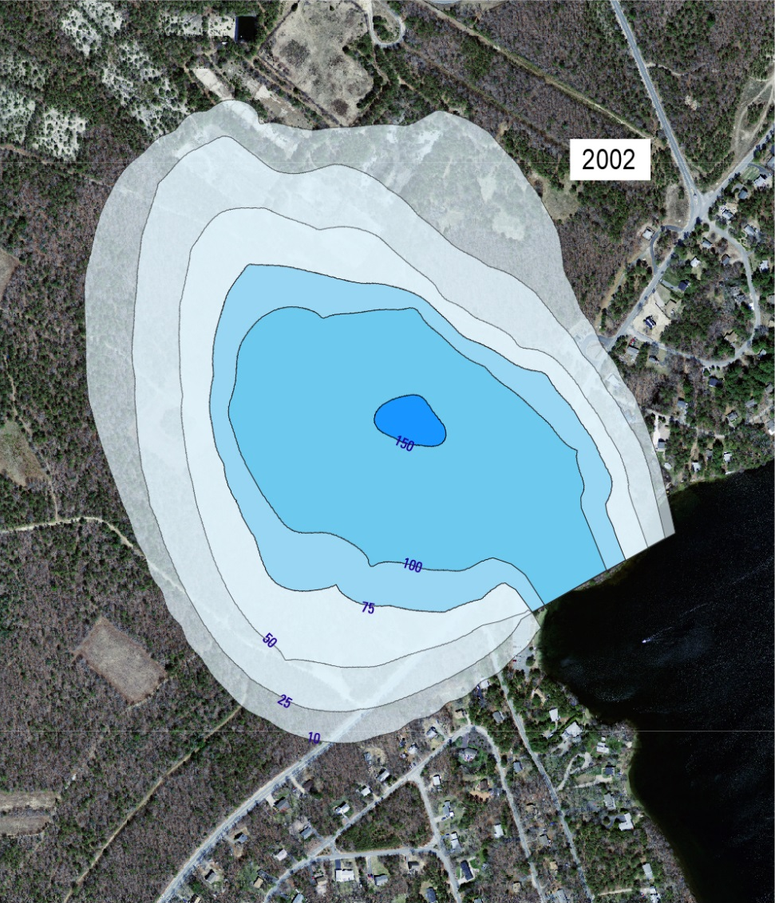
Model Prediction
2002

Slide 5

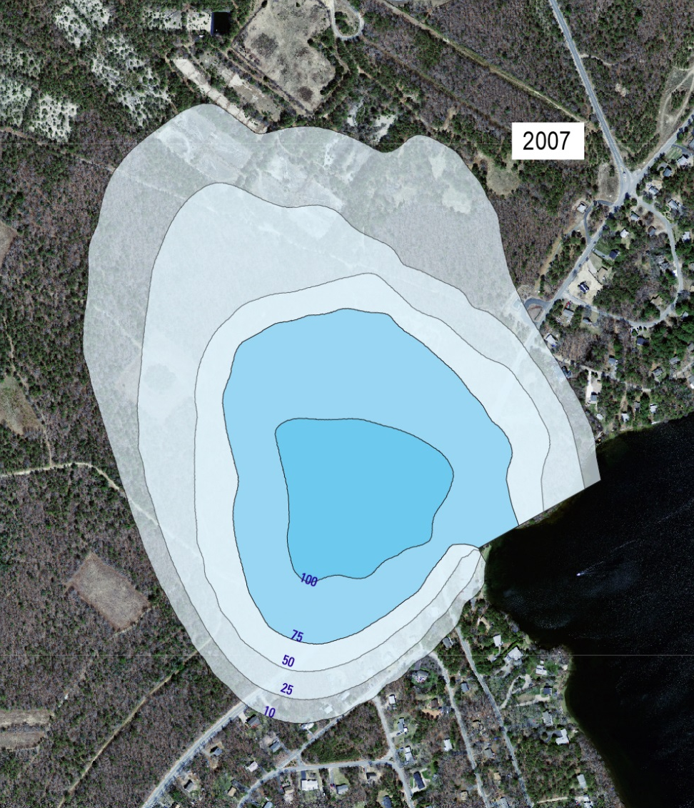
Laboratory Results
Model Prediction
2007
2007

Slide 6

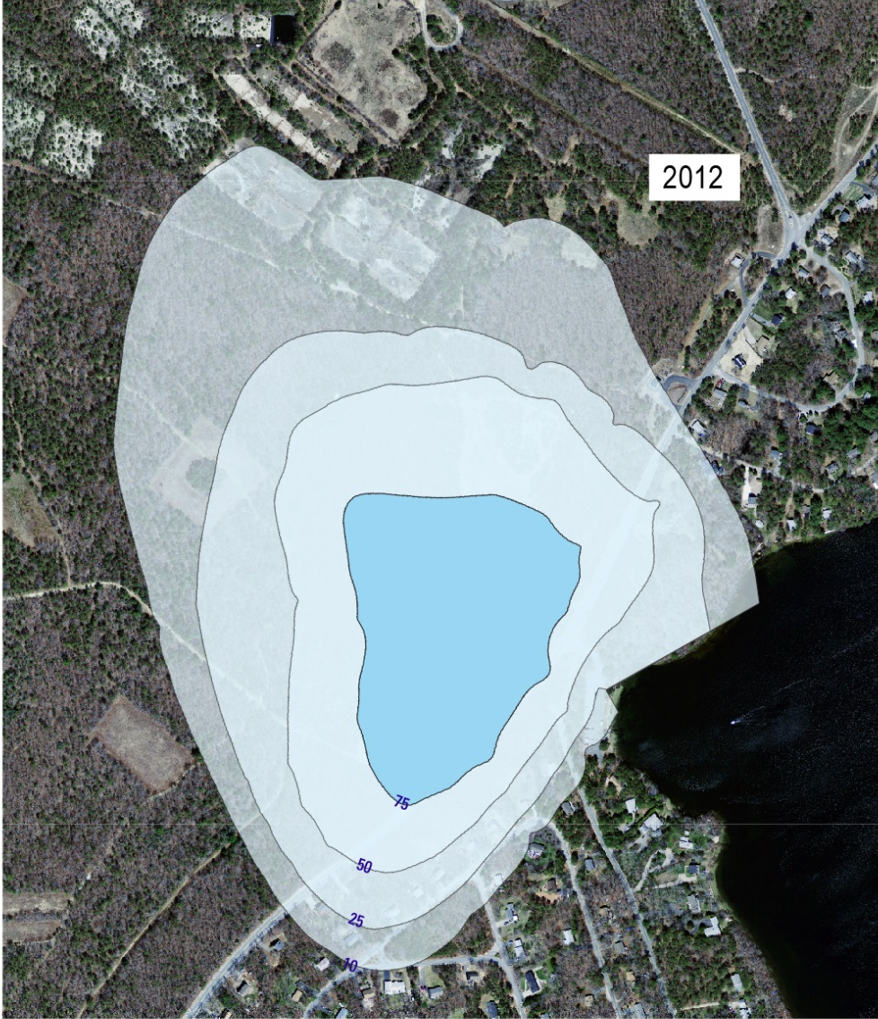
Laboratory Results
Model Prediction
2012
2012

Slide 7


Laboratory Results
Model Prediction
2014
2014

Slide 8
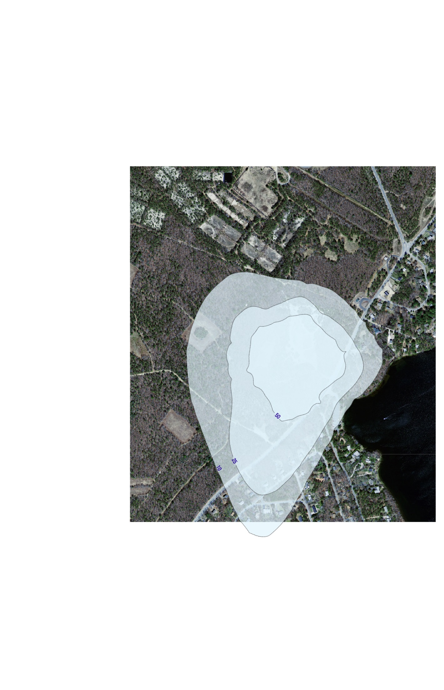
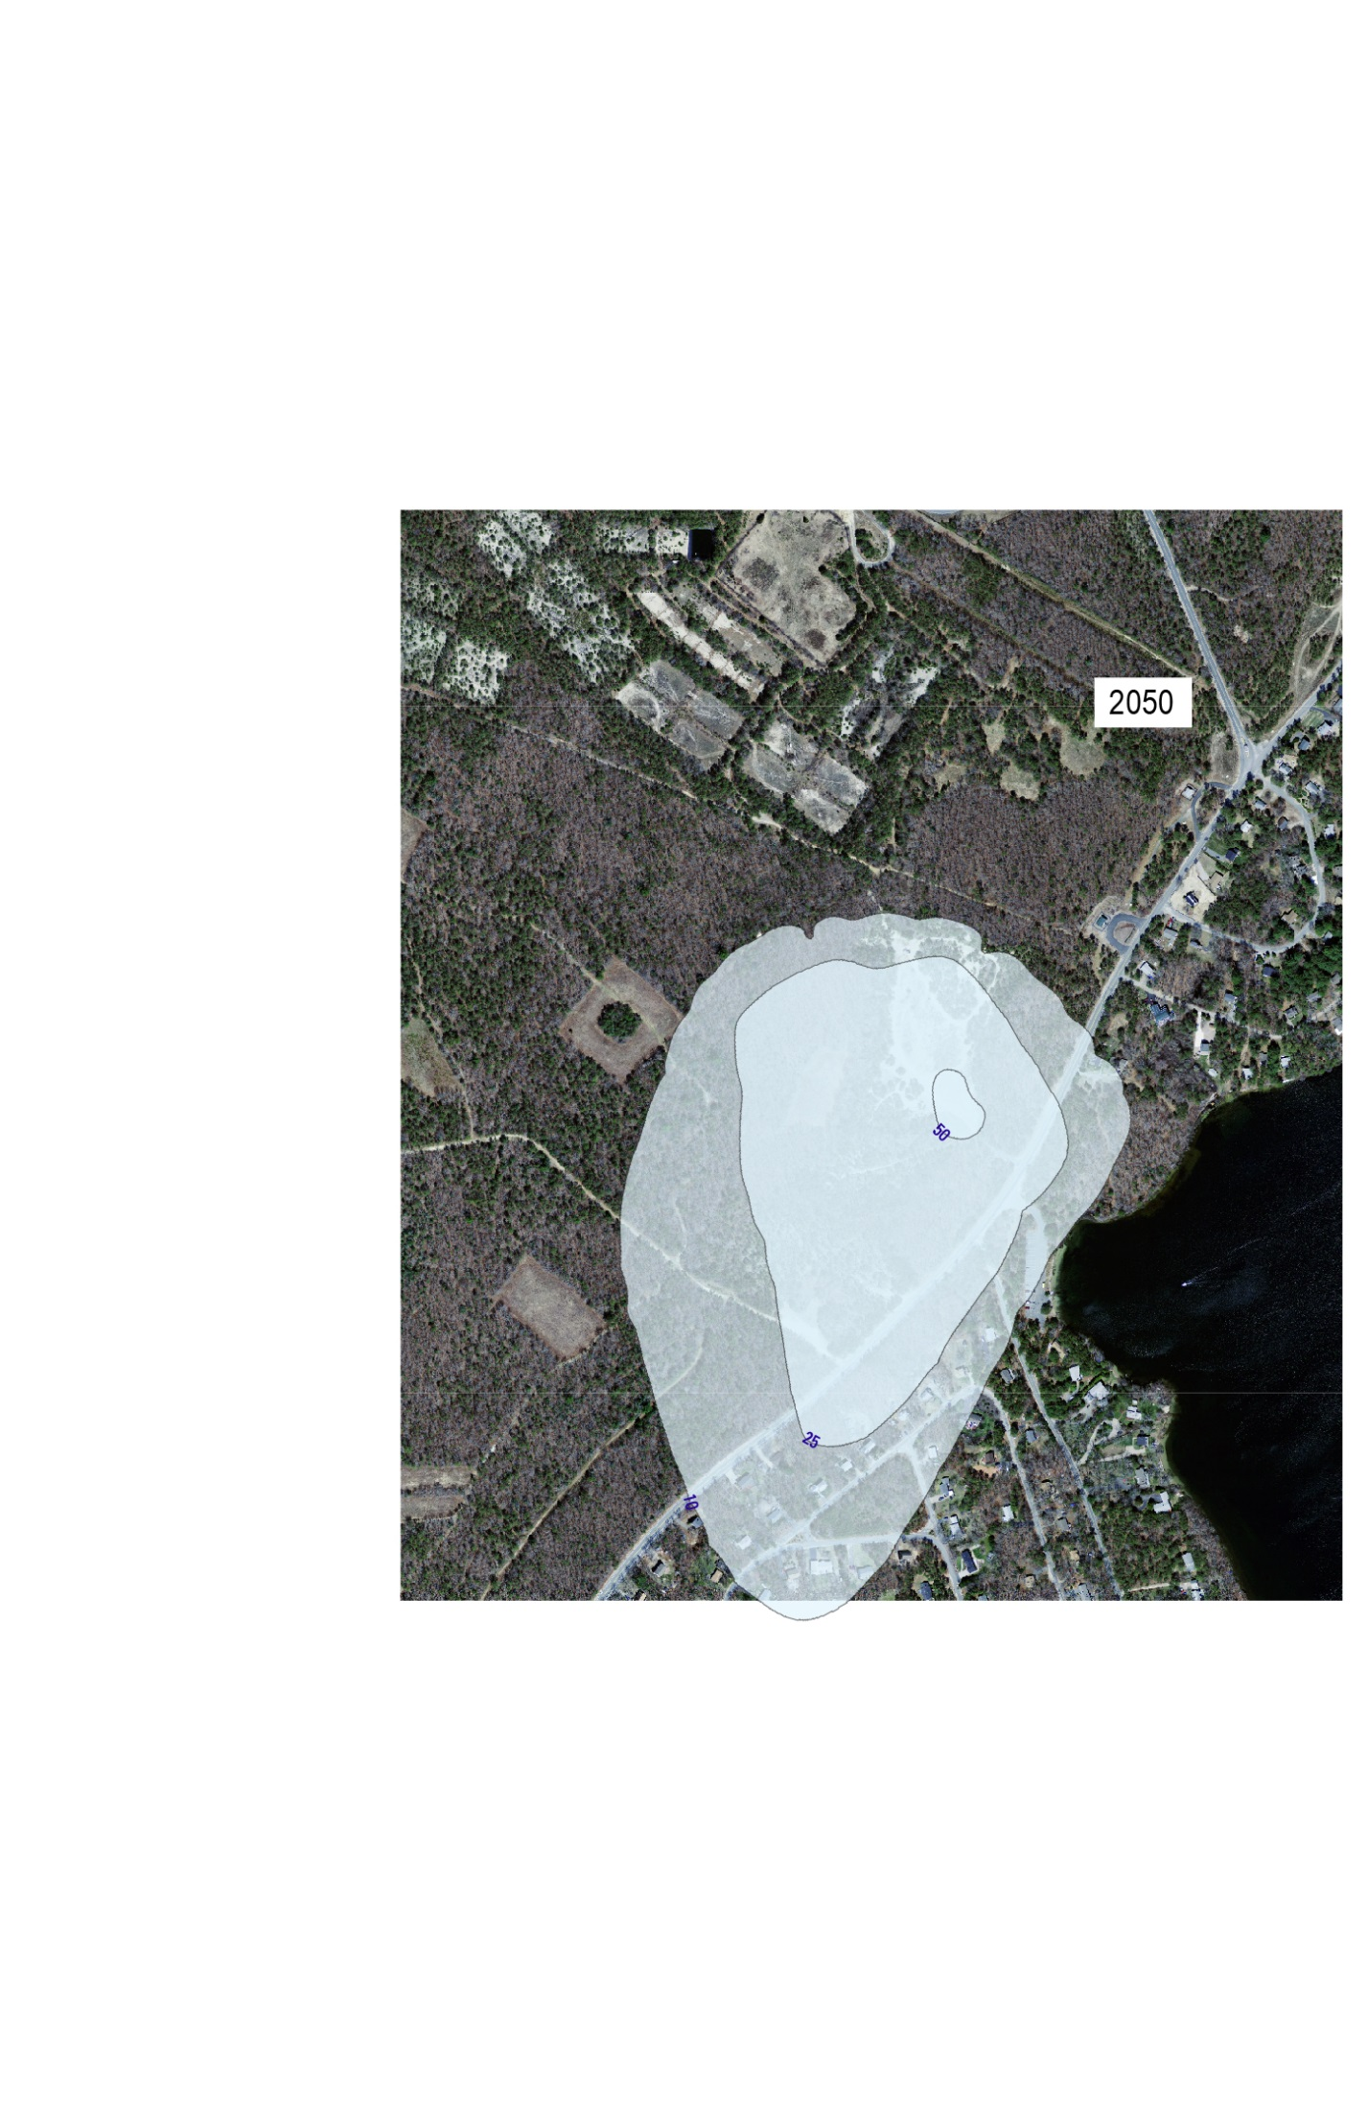
Model Prediction
Model Prediction
2030
2050

Slide 9
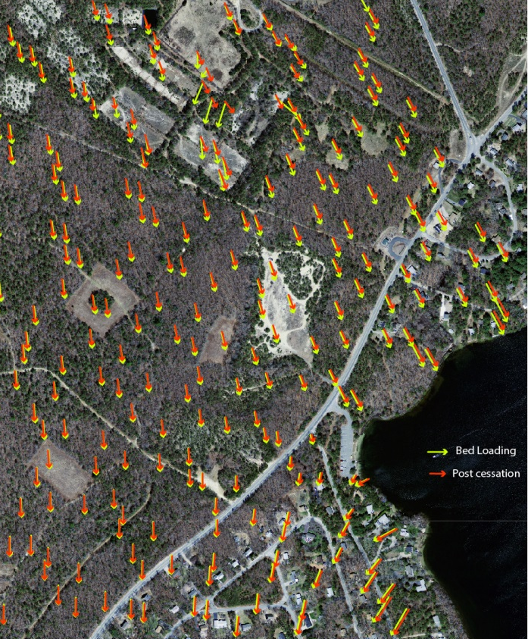
Simulated Flow Vectors

